Slide 1
Mate-Pair Update
Brendan O’Connell
Steven Weber
Green Lab

Slide 2
Why Mate-Pair?
Long distance information is required in order to scaffold together contigs generated by shotgun data
The goal of making a mate-pair library is to generate reads that contain information about the ends of very long inserts (2-10kb)
It is very important to size select this DNA to a tight size range
This gives us concise information about how many “N’s” exist between contigs

Slide 3
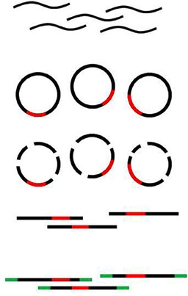
Molecular Biology Review
DNA sheared and size selected to a specific range
Biotinylated linker molecule ligated to both ends of insert, resulting in circularization
Exonuclease of any non-circular fragments
Shearing of circular DNA followed by Illumina library prep

Slide 4
Problems we have encountered
Lucigen Mate-pair kit gave us very low complexity libraries
One big problem is that a very small percent (5-10%) of your sheared DNA makes it through the tight size selection process
Only 5-10% of this size selected DNA ever actually gets circularized with the molecular biology of the Lucigen kit
This means that only ~2.5ng out of every 1ug of DNA is ever actually circularized
If your initial insert length is 4kb and your finished illumina library is 400bp, this means only 10% of your circular DNA actually contains junctions
This means that less than 1ng out of every 1ug processed are actual mates

Slide 5
Troubleshooting
One way to compensate for this extreme loss is to start with a very large amount of DNA
This works as long as you have a very large source of DNA, which is not always the case
Another way is to change the molecular biology to be more efficient
We were introduced to a method of library prep using an enzyme called Tn5, or Tagmentase

Slide 6
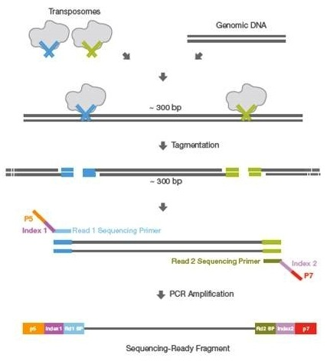
Tagmentase
Tn5 is an enzyme that recognizes and binds a specific 19bp sequence
In order to become an active “Transposome” it must bind two of these sites
Exposing the Transposome to long strands of DNA causes it to cut and ligate the bound fragments to either side of the cut
In this case, we have Illumina adapters downstream of this 19bp recognition site being loaded into the Transposome
This process replaces the shearing, end repair, adapter ligation, and adapter fill-in with just one reaction

Slide 7
Tagmentation
Loaded Tn5
Tn5 will load virtually any fragment that contains the 19bp recognition site
If we design oligos that will be loaded by Tn5, contain biotin and a palendromic overhang, we can use it to shear our DNA to any size and then proceed directly to circularization
Digest all linear DNA away and perform a second Tn5 reaction, this time with Illumina adapters loaded into the Transposome
Biotin enrichment and PCR
3kb
Tn5 shears DNA to 3kb and ligates linkers
Identical biotinylated linkers w/ GCGC overhang
Circular DNA
Shear and ligate adapters with 2nd Tn5 reaction

Slide 8
Pros and Cons
PROS
Very fast and efficient, skips many clean-up steps
Linker sequence found more commonly in the middle of the sequence
CONS
Increased chimeric rate
Longer linker sequence
Not as fine-tuned as the shearing protocol

Slide 9
Analysis Discussion
Throwing out reads that are not “true mates”
Differences in linker sequence
Saving reads where no linker sequence is found

