Slide 1
Sequence assembly
overlap
layout
consensus
s1
s2
s3
s4
s5
s6
s1
s1
s5
s1
s5
s2
s2
s2
de novo
s3
s3
s3
s4
s4
s4
s5
s6
s6
s6
reference-
guided
Reference sequence
s1
s5
s3
s4
s2
s6
Notes:
STOPPED HERE

Slide 2
de novo sequence assembly
Most CPU and memory demanding stage
overlap
s1
s2
s3
s4
s5
s6
Phrap: “banded” alignment of reads around k-mer matches; tolerate alignment mismatches of low-quality bases
s1
s2
s3
Phusion: group reads sharing >= 11 k-mers of 17 bases
s4
s5
Celera: k-mer seed and extend alignment of reads
s6
Arachne: 24-mer seed and extend alignment of reads
newbler: flowgram similarities (?)

Slide 3
Read 1:AACGTAGCTAC
Read 2:AGCTACGG
Read 3:CGTAGCT
AACGT
ACGTA
CGTAG
GTAGC
TAGCT
AGCTA
GCTAC
CTACG
TACGG

Slide 4
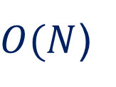
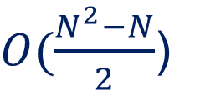
overlap
layout
consensus
s1
s2
s3
s4
s5
s6
s1
s1
s5
s1
s5
s2
s2
s2
O-L-C
s3
s3
s3
s4
s4
s4
s5
s6
s6
s6
$O(\frac{N^{2}−N}{2}$)
De Bruijn graph
$O(N$)

Slide 5
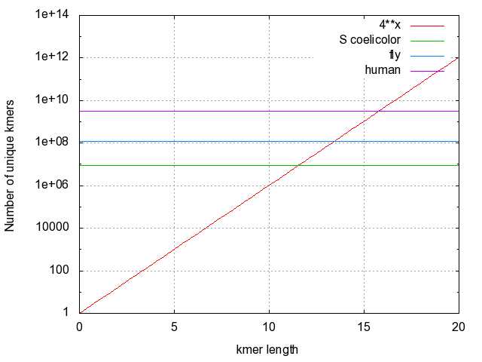
Theoretical genome uniqueness
K-mers:
words of length k
How many k-mers of length n?
4^{n}

Slide 6
Genomes are not random k-mers

Slide 7
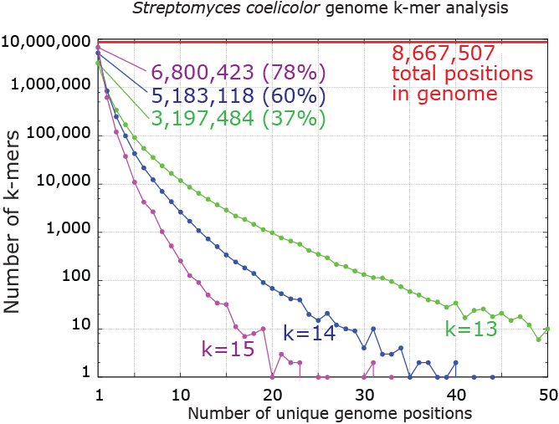
Genome uniqueness

Slide 8
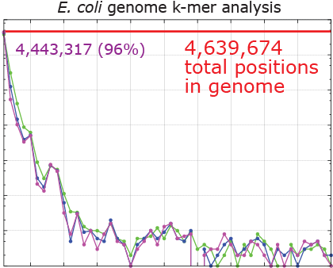

Slide 9
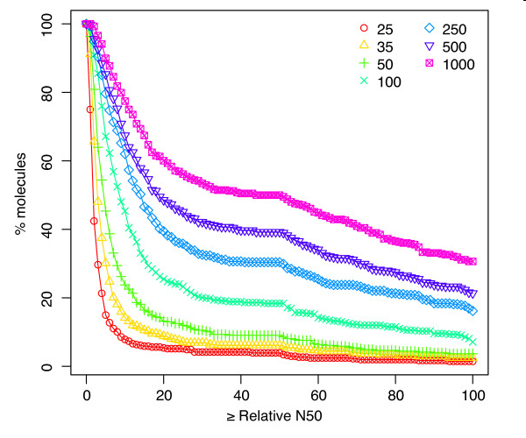
Absence of repeat sequence simplifies assembly
From 384 completely assembled bacterial and archaeal genomes
Relative N50 = N50 / chromosome length
Kingsford et al. BMC Bioinformatics 2010 11:21 doi:10.1186/1471-2105-11-21

Slide 10
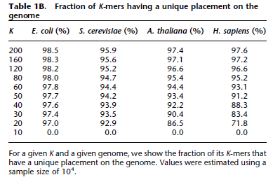
Butler et al, 2008 Genome Research 18:810

Slide 11
K-mer spectra to estimate genome size
Unique in k-mer space
Not unique in k-mer space
Depth of coverage = D
Total genome size =~ S / D
Where S = total sequence data &
D = mode of k-mer spectra

Slide 12
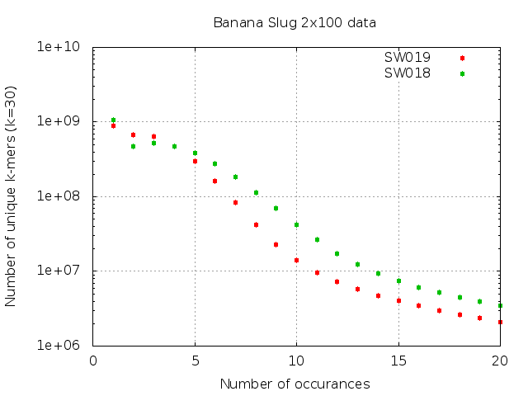

Slide 13
Other k-mer related questions about genome composition:
What fraction of the genome is in multi-copy repeats?
What fraction of the genome is heterozygous?
What fraction of the genome is in low-complexity regions?

Slide 14
K-mer spectra analysis for error correction
ACGTACGAGTCGATGATCGTCATGC
Low-quality base
What if this 25-mer occurred once in a dataset of 30-fold genome coverage?
What if a similar k-mer occurred 30 times in a dataset of 30-fold genome coverage?
Quake: http://genomebiology.com/2010/11/11/R116

