Slide 1
Announcements
Lucigen mate-pair data are available – check the wiki
Need to decide what additional data to collect
Your first presentations:
How does the assembler work (theory)?
What are the theoretical advantages of the approach implemented in your assembler?
What was your user experience?
Some results
Grading

Slide 2
Contiguity
Total genome length = N
Stop counting sums when length = N/2
N50 is length of this contig/scaffold

Slide 3
Limitations of N50 (or Nx)
Join everything!
How to check for false scaffolding:
Gene contiguity correctness from RNAseq or other data
Paired-end mapping
Synteny analysis

Slide 4
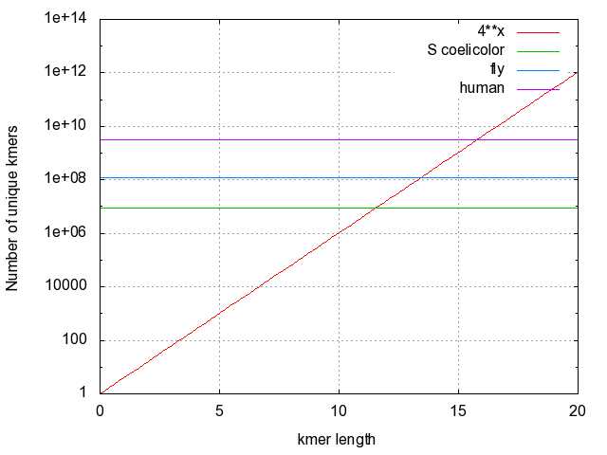
Theoretical genome uniqueness
K-mers:
words of length k
How many k-mers of length n?
4^{n}

Slide 5
Read 1:AACGTAGCTAC
Read 2:AGCTACGG
Read 3:CGTAGCT
AACGT
ACGTA
CGTAG
GTAGC
TAGCT
AGCTA
GCTAC
CTACG
TACGG

Slide 6
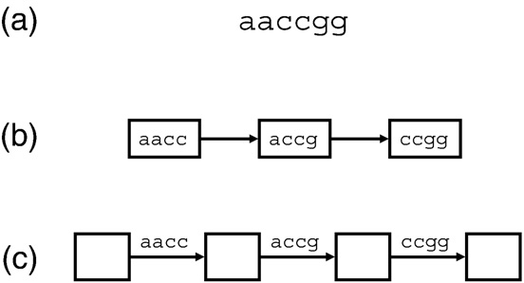
de Bruijn graph

Slide 7
Implication of k
read length = L
k
K should be long enough so that most single-copy genome regions
are unique
Number of k-mers = L – k + 1
Number of arcs = L – k
In case of sequencing error: k-mers affected = k

Slide 8
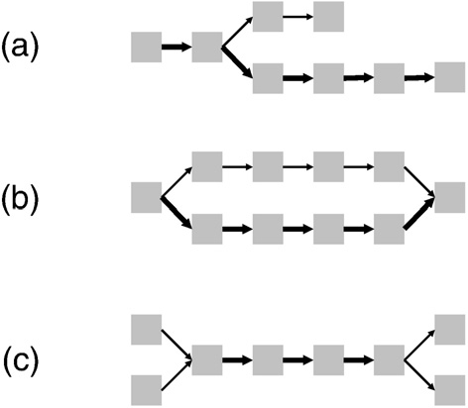
What could possibly go wrong?

Slide 9
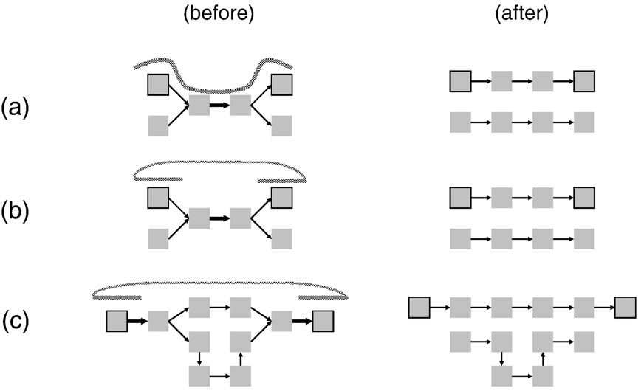
Long reads and/or paired reads can resolve ambiguities

Slide 10
Velvet: a de Bruijn graph assembler
Tip removal
Tour bus (bubble collapse)
Bread crumb (paired-ends data)

Slide 11
Allpaths-LG
Forward read
Reverse read
Find all possible “closures” for each read-pair
-Use only genome-local sequence reads
-Use only reads of appropriate single-copy coverage
-many other heuristics

Slide 12
Overlapping read pairs for de facto longer reads
Forward read
Reverse read
Insert length
Read length

Slide 13
Local error correction by k-mer analysis
Forward read

Slide 14
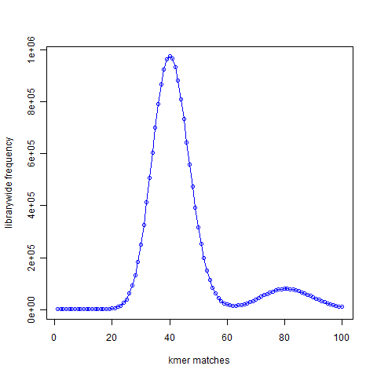
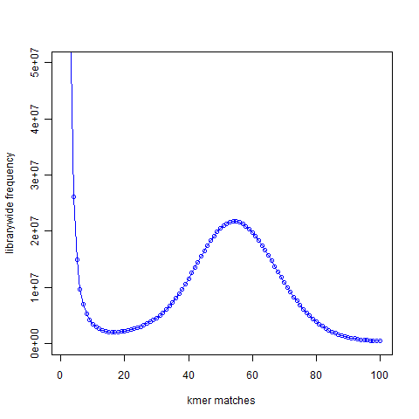
K-mer spectra from shotgun genomic data
Error-free data
Real data

