Slide 1
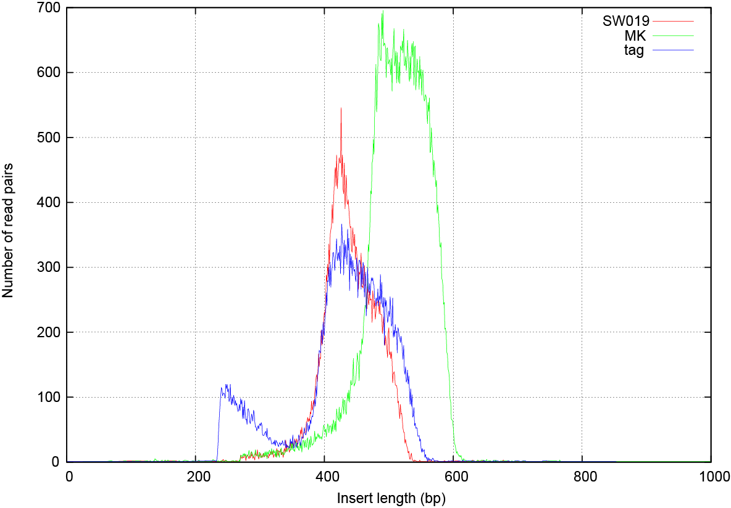

Slide 2
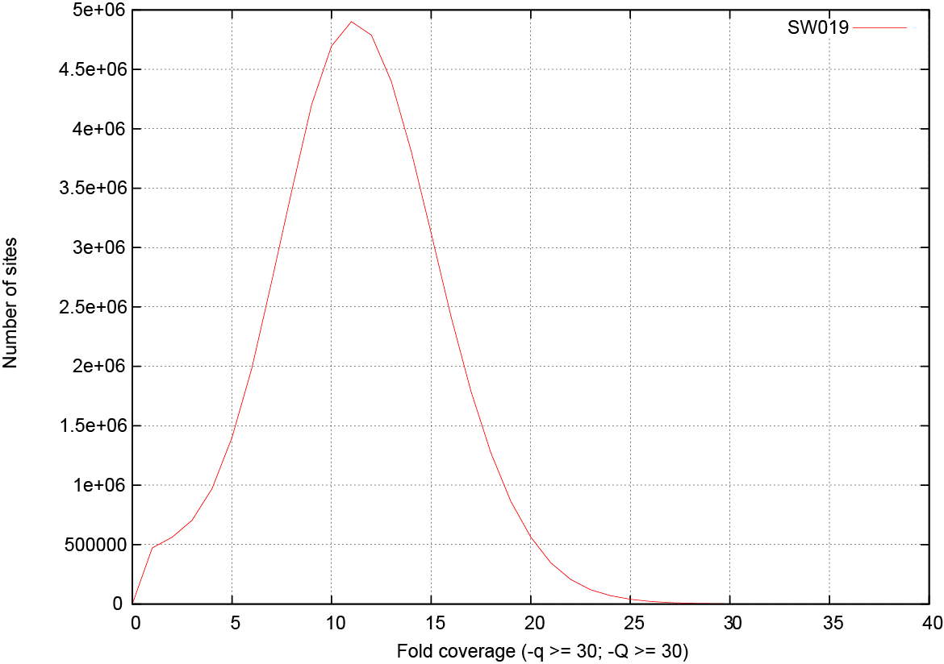

Slide 3
Heterozygosity

Slide 4
American alligator
Banana slug
Notes: SW019 2x250 library against all Discovar contigs > 50kb; ~50Mb
-Q & -q > 30 in samtools
Coverage = 14

